Slide 1

Attrition Rate

Slide 2

Insight Global Indicate businesses should generally aim for an attrition rate of
10% or lower.
1,5 - 2 Times
Of the worker’s annual salary as a cost for replacing an individual company.
Business can maintain their organizational knowledge through employees retention.
So, the companies are need for looking effective way to reduce attrition rate

Slide 3
Problem Definition
16%
employee attrition rate. It is crucial for the company to take measures to reduce this attrition rate in order to maintain a healthy and stable workforce.

Slide 4
Scope Definition
The data is annual from last year.
The analysis focus on attrition because of voluntary resignation
Attrition due performance is not discoverable because this datasets only contains score 3-4

Slide 5
Research Question
How to reduce annual attrition rate due to voluntary resignation from 16% to 10%

Slide 6
Data Sources
Primary Key | Employee Number
Boolean | Attrition, Gender, Overtime
Numerical | Monthly Income, Percent salary hike, Years at Company, Years at current role, Age, Years at company, Training Last Time, Years with current Manager
Nominal | Department, Education field, Job Role
Ordinal | Various satisfaction level, job involvement, stock options, work-life balance, job level, and performance Rating

Slide 7


Understand our Cowokers
Former Employee
Current Employee
Total Employee: 237
Total Employee: 1233
732
87
150
501

Slide 8
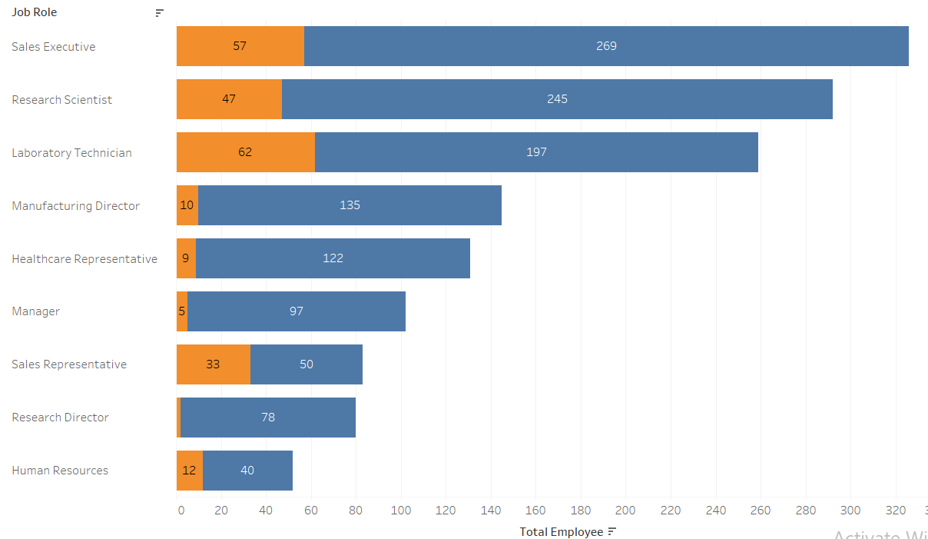

Total Employee per Job Role

Slide 9

Why company experience Attrition 16% yearly
Stock Option
Low Income
Years With Current Manager
Approximately 14% of former employees were limited to receiving stock at levels 0 and 1, indicating a disparity in stock allocation.
Around 12.65% of current employees have monthly incomes below the median
Employees who leave the company tend to do so within the first two years of their employment. We also Observe the former employee experience bad work environment and relationships statisfaction
Link Here

Slide 10
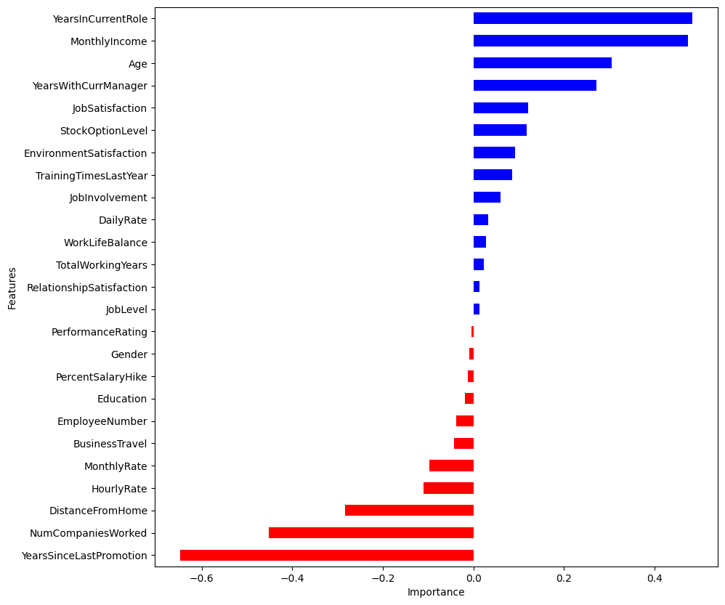
Logistics Regression - What Factors affect Attrition
Factors that
Contribute to Attrition
Factors that do not Contribute
Model Score: 0.85

Slide 11
Executive Summary
We can reduce annual attrition rate due to voluntary resignation from 16% to 10% by:
Reduce Overtime
Allow Managerial rotation in the first year every month
Increasing Monthly Income
Give Stock Option Benefit

Slide 12
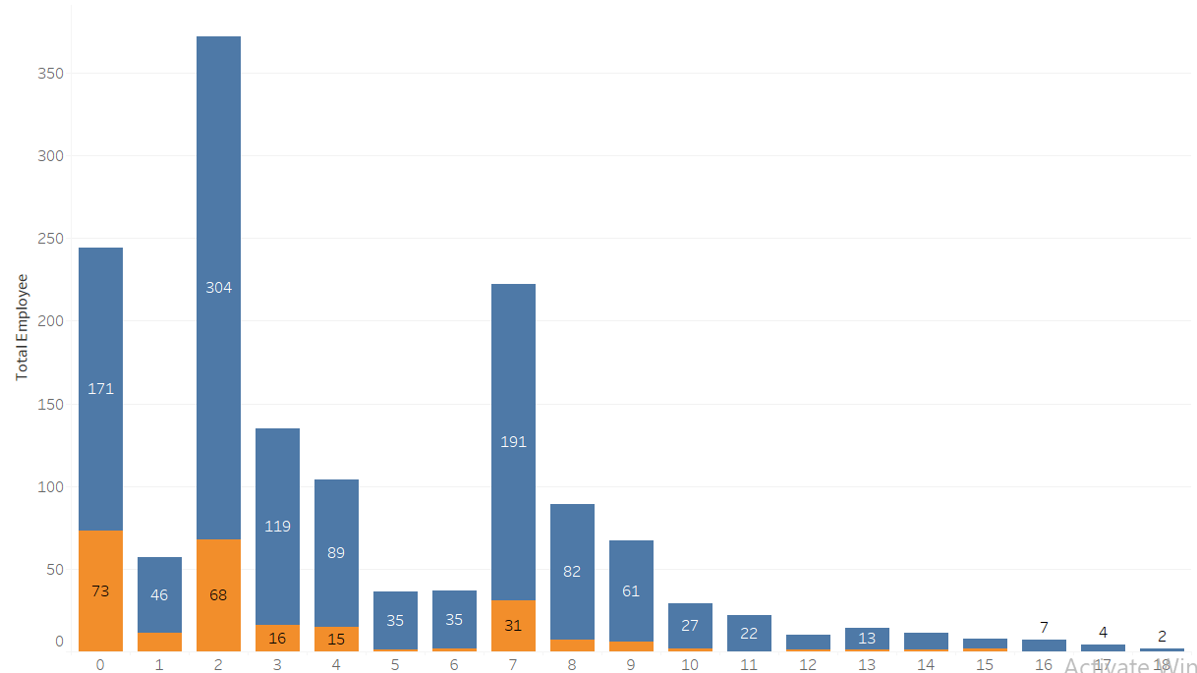
Years in Current Role
Employee Who Stay
Employee Who Leaves
Year
The majority of our former employees tend to leave the company during their first and second years of employment.

Slide 13
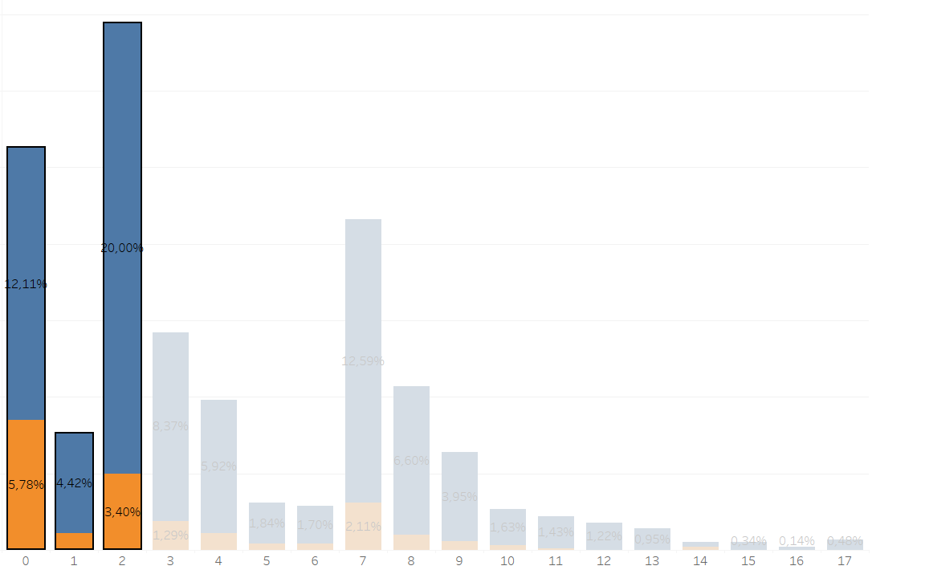
Years With Current Manager
We have identified a consistent pattern where employees who leave the company tend to do so within the first two years of their employment. This observation aligns with the previous chart and reinforces the significance of the 0-2 year timeframe in relation to employee attrition.

Slide 14
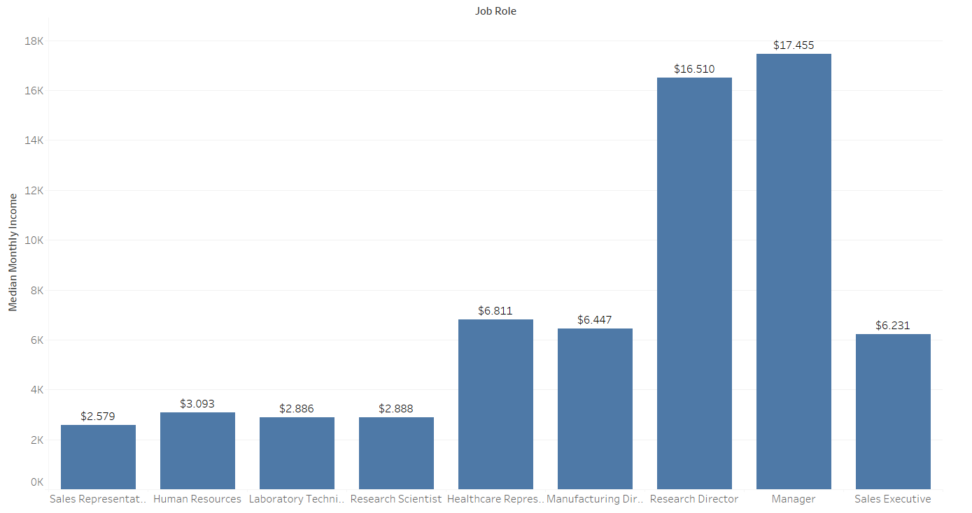
Monthly Income
We Observe that 4 job role have salary below median line
Median Line

Slide 15
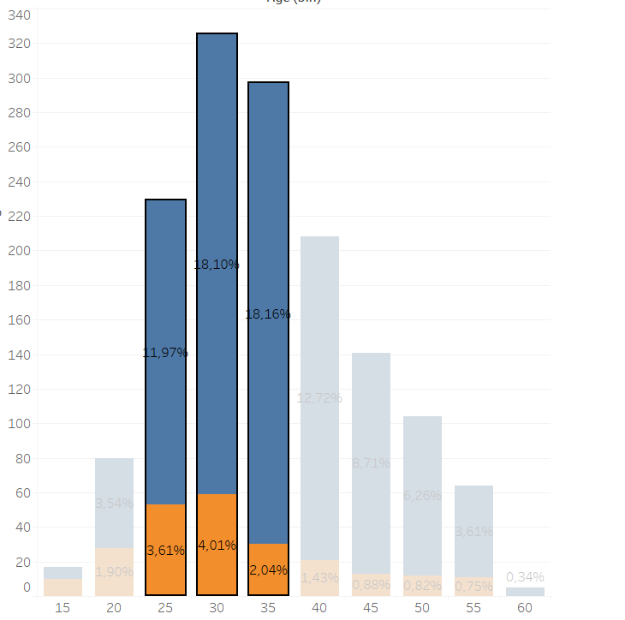
Age Differences
Our analysis reveals that a significant number of employees who voluntarily leave the company fall within the age range of 25 to 39, with the highest concentration occurring specifically between the ages of 30 and 34.

Slide 16
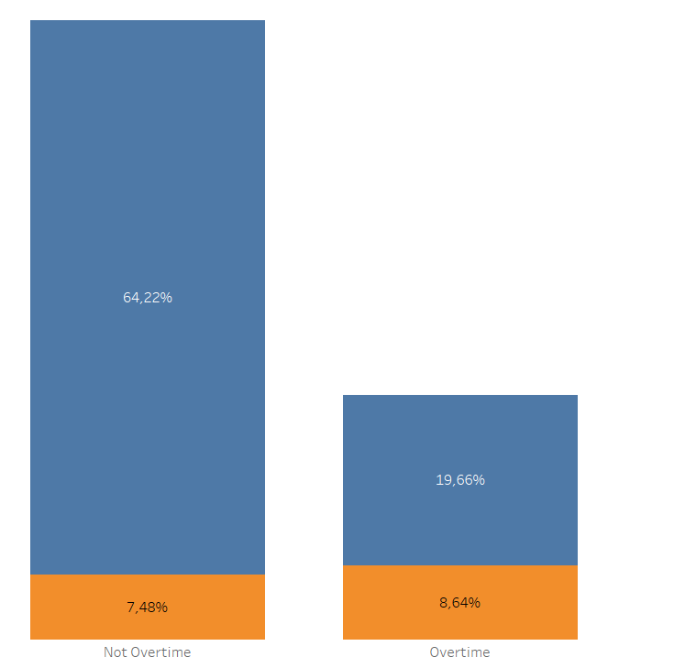
Former Employee and Current Employee Overtime
It has been observed that 8.64% of our former employees worked overtime, while the current workforce shows a higher rate of overtime work, with 19.66% of employees engaging in overtime hours.
Current Employee
Former Employee

Slide 17
Root Cause
Proposal Plan
Low salary | If we can Increase Base Salary by 5% before performance appraisals, we can reduce the employee’s attrition by 1.09%
Stock Option | If we Grant Level 2 of stock option who works more than 3 years, it will reduce attrition rate by 2%
Years With Current Manager | If Allow Managerial rotation every 6 months, it will reduce attrition rate by 3% in the first year
Overtime | If we allow Flexible work arrangements it will reduce attrition rate by 4%

Slide 18
Appendix
Google Colab: Hyperlink
Correlation Matrix: Hyperlink

